Slide 1
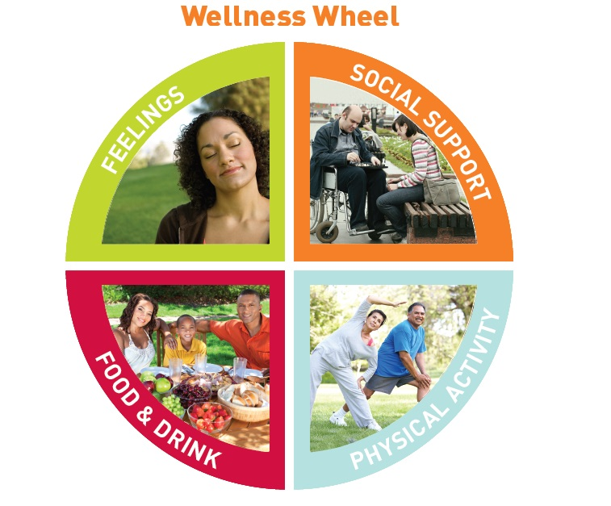
Direct Support Wellness professional (DSWP)
An overview of new age service delivery and agency redesign

Slide 2
The Mission is possible!
You are about to embark on a journey that will change your life. The core concept is to incorporate Wellness and a Holistic approach in how you do your job, operate your business and live your life.
Through a holistic approach we will provide a Wellness balance in the lives of persons served and staff. In other words when you practice what you preach you will become more mindful in all that you do!
Be sure to review the corresponding workbook before beginning.
The following presentation is intended to walk you through the current system and how we wish to incorporate Wellness.

Slide 3
DSP concepts wellness additions
Current concepts being included:
DSP Code of Ethic
Person Centered Thinking
*Good Life – 4 Hats
Positive Culture – Emotional First Aid
ISP (Individual Service Plan) / Imagine planning / outcomes
Community Inclusion
* Denotes future training topics
Wellness Concepts to incorporate:
What is Mindfulness
Using a Holistic Approach
MBSR – Stress Reduction*
Living Well with a Disability*
Wellness Coaching )*
Healthy Living *
Individual Wellness Plans (IWP) *
Core Areas / Goal Setting

Slide 4
CURRENT CONCEPTS AND HOW THEY CORRELATE
DSP ETHICS
GOOD LIFE
POSITIVE CULTURE
TRAUMA INFORMED CARE
EMOTIONAL FIRST AID
SUCCESS PLANNING

Slide 5
DSP CODE OF ETHICS – Let’s discuss how they relate to Wellness Approaches
1. Person-Centered Supports: My first allegiance is to the person I support; all other activities and functions I perform flow from this allegiance.
2. Promoting Physical and Emotional Well-Being: I am responsible for supporting the emotional, physical, and personal well-being of the individuals receiving support. I will encourage growth and recognize the autonomy of the individuals receiving support while being attentive and energetic in reducing their risk of harm.
3. Integrity and Responsibility: I will support the mission and vitality of my profession to assist people in leading self-directed lives and to foster a spirit of partnership with the people I support, other professionals, and the community.
4. Confidentiality: I will safeguard and respect the confidentiality and privacy of the people I support.
5. Justice, Fairness and Equity: I will promote and practice justice, fairness, and equity for the people I support and the community as a whole. I will affirm the human rights, civil rights and responsibilities of the people I support.
6. Respect: I will respect the human dignity and uniqueness of the people I support. I will recognize each person I support as valuable and help others understand their value.
7. Relationships: I will assist the people I support to develop and maintain relationships.
8. Self-Determination: I will assist the people I support to direct the course of their own lives.
9. Advocacy: I will advocate with the people I support for justice, inclusion, and full community participation.
DISCUSS HOW THE BOLD WORDS FIT IN TO THE WELLNESS WHEEL AND ASSOCIATE SUPPORTING HOLISTICALLY

Slide 6
GOOD LIFE
Positive Culture and Good Life Network Training are beneficial concepts to creating a holistic program with a wellness focus. We often only address what is in an individual’s ISP or goals that relate to one aspect of the whole. Frustration arises as varied providers work on different outcomes and life areas. If we begin to take the approach to aide in the lives of persons as a whole we will develop relationships with the individual’s network and overcome barriers as a team.
I WANNA SEE YOU BE BRAVE ! -- {Clip of FCBDD Good Life Initiative}
FIND YOUR WORD – USE IT TO FIND COMFORT , STRENGTH , FOCUS whatever it is you need to cheer yourself on! {Write your word on the paper provided and post it up}

Slide 7
Positive Culture - Key Points for all levels of PCI
Healthy Relationships
Striving to bring out the best in each other
Acknowledging the goodness in others
Actively supporting others to be successful
Positive Culture - Beliefs
Our actions & thoughts must be intentional
There is no place in our profession for the use of power, control or coercion
The focus is on possibilities & quality of life
Positive Culture - Practices in a Healthy Organization
Intentional focus on creating healthy relationships
Intentional conversations focused on what is possible
Intentional conversations focused on quality of life
Positive Culture - Actions in a Healthy Organization
We support one another to be more humane in our work
We support & encourage a spirit of gentleness in our work and daily interactions
We focus our conversations on possibilities & quality of life
What is a Positive Culture for People served by the DD system
An intentional way of supporting people that focuses on:
Truly knowing and valuing the person;
Creating healthy relationships;
Acknowledging the difficulties they face;
Offering encouragement and support;
Providing safe interactions during times of crisis.

Slide 8
Trauma Informed Care – Becoming “trauma-informed” means recognizing that people often have many different types of trauma in their lives. People who have been traumatized need support and understanding from those around them. Often, trauma survivors can be re-traumatized by well-meaning caregivers and community service providers. The TIC project seeks to educate our communities about the impact of trauma on clients, co-workers, friends, family, and even ourselves. Understanding the impact of trauma is an important first step in becoming a compassionate and supportive community. Understanding the Trauma from the past that onsets future trauma
Trauma Informed Care is an organizational structure and treatment framework that involves understanding, recognizing, and responding to the effects of all types of trauma. Trauma Informed Care also emphasizes physical, psychological and emotional safety for both consumers and providers, and helps survivors rebuild a sense of control and empowerment.

Slide 9
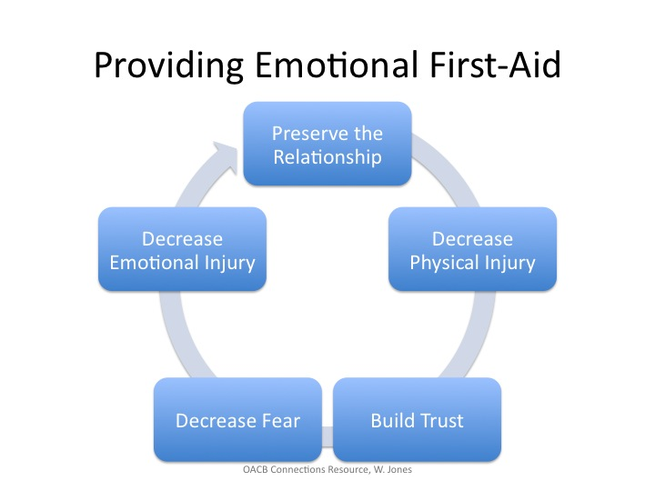
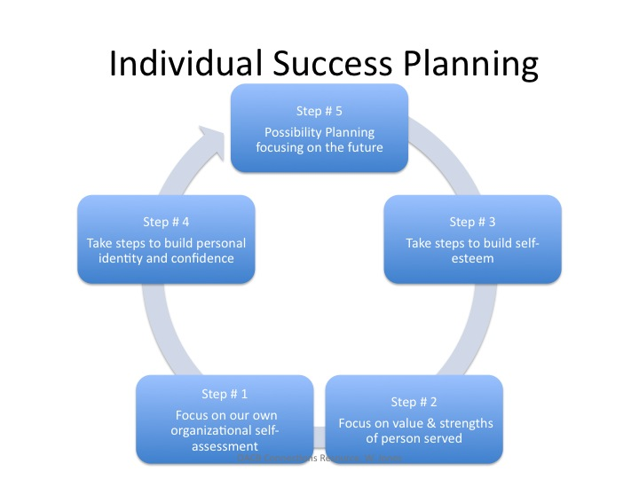
Emotional First Aid & Individual Success Planning

Slide 10
THE FUTURE IS HERE!
WELLNESS CONCEPTS
HOW TO RELATE TO BEING A DSP & TO IMPROVE YOUR WAY OF LIVING

Slide 11
Definition of Wellness
The term wellness has been applied in many ways. Although there might be different views on what wellness encompasses, the National Wellness Institute--along with the help of leaders in health and wellness--shared many interpretations and models of wellness.
Through this discussion, there appears to be general agreement that:
Wellness is a conscious, self-directed and evolving process of achieving full potential
Wellness is multidimensional and holistic, encompassing lifestyle, mental and spiritual well-being, and the environment
Wellness is positive and affirming
The definition of wellness, long used by the National Wellness Institute is consistent with these tenets.
Wellness is an active process through which people become aware of, and make choices toward, a more successful existence.

Slide 12

Six Dimensions of Wellness
We will use the six dimensions as a baseline and core areas as a foundation
CORE AREAS (reduced to four for simplicity)
Physical / Nutritional
Occupational / Environmental
Intellectual / Social
Emotional / Spiritual
We will discuss the Six Dimensions to allow you to develop a deeper understanding of Wellness as a whole. However for service delivery we will operate with four core areas, to design program goals.

Slide 13
Applying Wellness
By applying the Six Dimensional Model, a person becomes aware of the interconnectedness of each dimension and how they contribute to healthy living. This holistic model explains:
How a person contributes to their environment and community, and how to build better living spaces and social networks
The enrichment of life through work, and its interconnectedness to living and playing
The development of belief systems, values, and creating a world-view
The benefits of regular physical activity, healthy eating habits, strength and vitality as well as personal responsibility, self-care and when to seek medical attention
Self-esteem, self-control, and determination as a sense of direction
Creative and stimulating mental activities, and sharing your gifts with others
Applying a wellness approach can be useful in nearly every human endeavor

Slide 14
We will ask ourselves the following questions to determine if the activities we are implementing meet the associated Wellness approach.
Does this help people achieve their full potential?
Does this recognize and address the whole person (multi-dimensional approach)?
Does this affirm and mobilize peoples' positive qualities and strengths?

Slide 15
Mindfulness-Based Stress Reduction
https://palousemindfulness.com Use this site to increase your skills in MBSR
* A Two hour training will be held in the future as part of the certification process as a DSWP.

Slide 16
What Is Mindfulness?
Mindfulness means maintaining a moment-by-moment awareness of our thoughts, feelings, bodily sensations, and surrounding environment.
Mindfulness also involves acceptance, meaning that we pay attention to our thoughts and feelings without judging them—without believing, for instance, that there’s a “right” or “wrong” way to think or feel in a given moment.
When we practice mindfulness, our thoughts tune into what we’re sensing in the present moment rather than rehashing the past or imagining the future.
HOW MINDFUL ARE YOU? TAKE THE MINDFULNESS QUIZ
(link provided on the mindfulness tab at http://creating-hope.us/)
Exercises: Raisin Awareness / STOP breathe / Face Lift

Slide 17
Living Well with a Disability
It’s a struggle for most people in our society to build healthy lifestyles that include eating balanced diets, being physically active, engaging in stress-reducing activities, and preventing specific health problems. Adults with disabilities are at risk for secondary health conditions, including pressure sores, chronic pain, fatigue, isolation, depression, and others. Healthy habits can prevent many secondary conditions, and people with healthy lifestyles usually feel better.
“Living Well” has two different and related meanings— developing healthy living habits and living a meaningful, rich life. These two meanings are connected. The Living Well concept helps participants learn about this connection so they can develop meaningful goals and their capacity to achieve those goals. This helps to facilitate discussion that encourages participants to explore this connection of living well for themselves.
*This is another 2 hour future training as part of the certification as a DSWP
WE MUST ENCOURAGE HEALTHY NUTRITION AND EXERCISE DAILY SO THE LIFE STYLE IS ADJUSTING HEALTHY HABITS

Slide 18
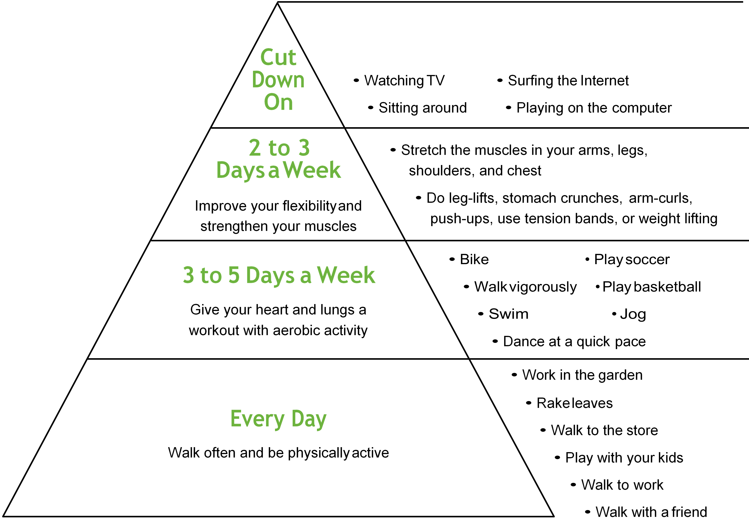
Healthy Living
Things to consider other than the gym?

Slide 19
Wellness Coaching
Wellness Coaches assist our clients in finding new ways to inspire healthier habits. They work closely with our clients and other employees in promoting wellness and helping individuals realize their personal best. Wellness Coaches will be responsible for developing a wellness coaching relationship with clients and assisting the client through the process of actively working towards better health by providing support, encouragement, and education.
A Two hour future wellness coaching training will follow this presentation as part of the certification as a DSWP

Slide 20
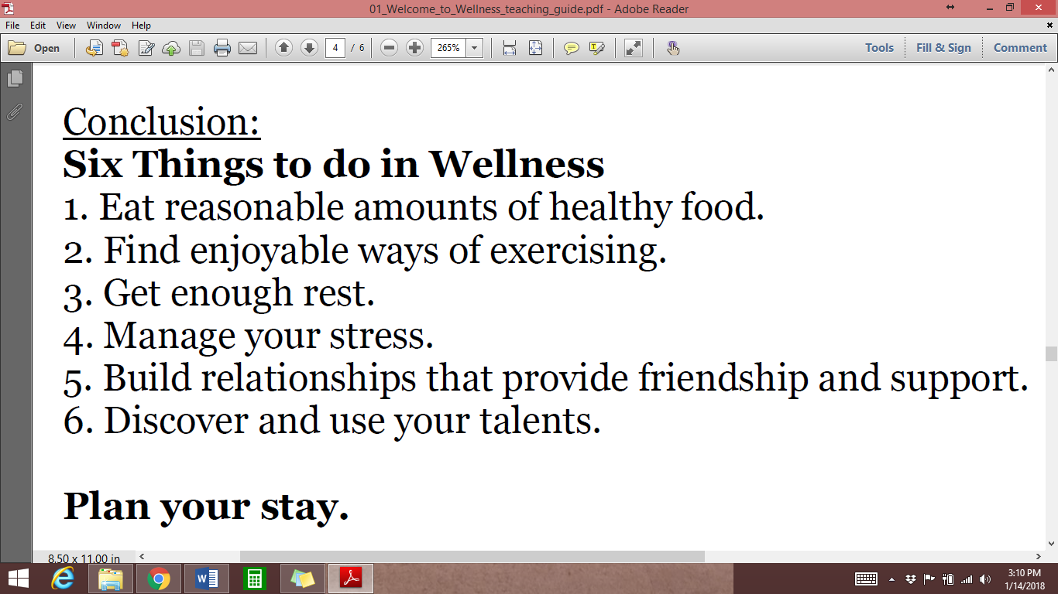
Out of these 6 things what personal goals can you develop?
How will you plan your stay?
Doing these things for yourself
as well as
clients will change your life!

Slide 21








Individual Wellness Plan
People who are successful at making lifestyle changes take time to write out a specific goals and a plan of action. Use this work sheet to write out your goals and action plans. Review the various area of your health. Decide in which areas you would like to make improvement. List your present situation and specify your goals (what you want to accomplish) in measurable terms.
Keep track of your progress. Review your goals regularly. Get help from others as needed.
We will track the following in the IWP for each individual
Weight
Healthy Eating
Physical Activity
Stress and Coping
Positive Environments
Addictive Behavior
Spiritual Health
Social / intellectual Health
Other
NOW let’s write Your IWP!
We will use the groups IWP’s to create core area concepts for training purposes, however you are encouraged to keep an active individualized plan and use your work family for support in your own transformation.
A Two hour training in the future in IWP writing will complete the DSWP certification

Slide 22
PROGRAMMATICALLY Applying the CORE Concepts
Daily Programming
First Develop a Lead
Gather IWP CORE GOALS
Every Day should include some form of physical activity and reinforce healthy living habits and nutrition.
Core areas should be addressed weekly by rotating topics and activities to assure each is touched upon. Many areas and Physical can be addressed in one day, while other days will encompass one area and Physical.
Example; Monday we go to library to research smoking cessation while stopping at grocery to purchase salad bar material to make upon return to facility and we exercise before going home. On Tuesday we go to the gym and volunteer at senior center. (Identify the core areas addressed)
FOR EACH OF THE FOUR CORE AREAS ASSIGN A LEAD TO BE RESPONSIBLE FOR THE TRACKING AND DEVELOPMENT OF GOAL ATTAINMENT ACTIVITIES AND IWP GROUP BRAIN STORMING
START TO DEVELOP IWP WITH PARTICIPANTS
USE THE WORK SHEETS PROVIDED WITH THE WORKBOOK FOR TRACKING
Once you have several IWP written for participants you can begin to form sessions and activities that will correspond with the individual and group goals.
Leads will make contact and arrange activities based from the brain storming sessions held monthly with the DSWP team.
Goals and Activities should be updated on an on going basis to assure services are not stagnate

Slide 23
These CORE AREA CONCEPTS should grow and be a part of the weekly brainstorming process to assure individual goals are staying in the fore front and opportunities are created that benefit the whole.
Community Inclusion is a MUST in ADS serve delivery according to the ORC 5123-2-9 people shall not be housed in an environment that isolates them from society. With the redesign of programs and service delivery we must assure persons are gaining every opportunity to be included in community options. A coordinated effort between wellness areas should occur as frequently as possible to increase options and assure balance within the structure of the program.

Slide 24
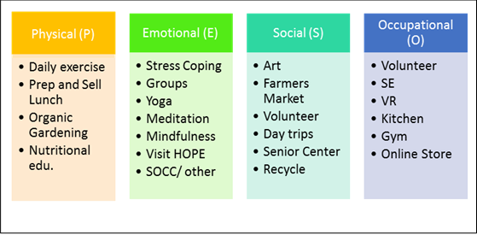
CORE AREA CONCEPT EXAMPLES for TEAM CONSULTING
(Practice Developing a Concept)
Let’s use the need for healthy eating verses expense of it as our first brain storming session!

Slide 25
We will follow a holistic approach that incorporates WELLNESS in to the everyday lives of those served and staff in all that we do.
Living and working holistically simply means we consider and encompass Mind, Body and Spirit into daily living. We attempt to identify where there is imbalance in an area and make mindful decisions to find balance with the Whole.

Slide 26


